Slide 1

DEPARTMENT OF COMPUTER ENGINEERING
Agricultural Recommendation System using Deep Learning
Avishkar Dalvi 20202002
Riddhi Narkar 19102003
Radha Rakshe 19102067
Aarya Totey 19102070
Under the Guidance of: Prof. Deepak Khachane

Slide 2
Problem statement
To implement a Machine Learning system that gives recommendations for Crop-Fertilizers pair based on the soil and weather conditions, also helps in identifying plant disease to provide a cure for the same using Deep Learning technology.
Agricultural Recommendation System using DL
Notes:
As easy as it might be to be a city dweller, we cannot ignore to the plights of our farmers. India has a primary sector economy, that means that majority of our population is involved in agricultural based activities and are dependent on crops related business for their livelihood. India, no doubt is an agrarian society, and we often tend to ignore this fact.
Multiple unsustainable technologies took a huge toll on our Earth in the recent past decades giving rise to global warming and climate as worldwide crisis. This hurts the farmer the most, as they are often lacking proper guidance and resources to solve their problems. Lal Bahadur Shastri once said, “Jai Jawan Jai Kisaan”, which believed in uplifting the role of a farmer. We tried to combat a few issues farmers face by providing a solution in the form of.
Farmerable is a website aimed at assisting the farmer. It consists of a crop recommendation system, a fertilizer recommendation system, and a crop disease identification system. All these would be implemented as ML models and integrated into a single webpage for easier and convenient access.

Slide 3
Project Features
EXISTING FEATURES
Crop Based Recommendation system – Recommends the favorable crops as per the soil details.
NEWLY PROPOSED FEATURES:-
Fertilizer Recommendation system – The user provides the details about the soil and system will give recommendations and solutions to improve the fertility of the soil.
Crop disease classification – The user needs to upload photos of the crop affected by the disease and the proposed system will classify the disease and will give recommendation to the farmer about how to cure the crop.
Agricultural Recommendation System using DL

Slide 4
Objective
To provide a single place to access help for crop related problems, the causes, and how to cure them, thus providing a solution based approach
To use recent technologies like Machine Learning’s powerful algorithms to help farmers
To make these services available over the internet to anyone who wants to access them
To try to make the UI as simple as possible so that a naïve user who doesn’t possess much knowledge about technology can easily navigate
Agricultural Recommendation System using DL

Slide 5
Scope
This project has the potential to assist a farming enthusiast or a occupational farmer to make smarter decisions on his harvest strategy
It can provide necessary guidance related to cultivation and fertilizer ideas and curing crop diseases
Since it is easily accessible for anyone with an Internet connection, it can gather more reach
Agricultural Recommendation System using DL

Slide 6
Technology Stack
Python 3.8 or higher
Numpy
Pandas
Scikit
Matplotlib
PyTorch
Flask
HTML
CSS
Agricultural Recommendation System using DL

Slide 7
References
Title of the research paper | Year published | Authors | Abstract
Plant Leaf Disease Detection and Classification based on CNN with LVQ algorithm IEEE Explore | 2020 | ﻿Melike Sardogan, Adem Tuncer, Yunus Ozen Department of Computer Engineering, Yalova University | ﻿The early detection of diseases is important in agriculture for an efficient crop yield. The bacterial spot, late blight, septoria leaf spot and yellow curved leaf diseases affect the crop quality of tomatoes. Automatic methods for classification of plant diseases also help taking action after detecting the symptoms of leaf diseases. This paper presents a Convolutional Neural Network (CNN) model and Learning Vector Quantization (LVQ) algorithm based method for tomato leaf disease detection and classification. The dataset contains 500 images of tomato leaves with four symptoms of diseases. We have modeled a CNN for automatic feature extraction and classification. Color information is actively used for plant leaf disease researches. In our model, the filters are applied to three channels based on RGB components. The LVQ has been fed with the output feature vector of convolution part for training the network. The experimental results validate that the proposed method effectively recognizes four different types of tomato leaf diseases.
﻿Crop Recommendation System ﻿International Journal of Computer Applications (0975 – 8887) Volume 175– No. 22, October 2020 | 2020 | ﻿Pradeepa Bandara, Thilini Weerasooriya, Ruchirawya T.H., W.J.M. Nanayakkara, Dimantha M.A.C, Pabasara M.G.P. Sri Lanka Institute of Information Technology, Sri Lanka | ﻿Recommendation system through integrated models of collecting environmental factors using Arduino microcontrollers, Machine learning techniques such as Naïve Bayes (Multinomial) and Support Vector Machine (SVM), Unsupervised machine learning algorithm such as K-Means Clustering and also Natural Language Processing (Sentiment Analysis) concerned with the Artificial Intelligence to recommend a crop for the selected land with site-specific parameters with high accuracy and efficiency. It has been a major problem to identify what to grow, any man has adequate space in the owner’s land. Not only domestic lands but also for farming lands. Why it has become a problem is that environmental factors such as temperature, water levels, and soil conditions are uncertain as they change from time to time. Due to these problems, this solution of crop recommendation system predicts the user, what crop type would be the most suitable for the selected area by collecting the environmental factors for plant growth and processing them with the trained sub-models of the main of the system.
Agricultural Recommendation System using DL

Slide 8
References
Title of the research paper | Year published | Authors | Abstract
﻿Machine Learning based Crop Recommendation System for Local Farmers of Pakistan A Research Gate Preprint Online Publication | 2021 | ﻿Sayed Mazhar Ali, Bhagwan Das, Dileep Kumar Department of Electronic Engineering, Quaid University of Engineering, Science and Technology, Nawabshah, Sindh, Pakistan. | ﻿In Pakistan, the most part of the land is used for agriculture cultivation to meet the desires of nearby people and export want as properly. Crop cultivation anywhere in the world depends on the climate so called seasons and soil properties, however, the enhancing the production of crops depend on various factors like mainly on temperature. In order to address the issue of increasing crop production for Pakistan, a crop recommendation system is proposed in this work. In this work, idea of ideal harvest prior to planting it, it would be of extraordinary assistance to the farmers and others required to settle on fitting choices on upgrading the creation of yields for neighborhood utilization needs and may prompt the capacity and expanded fare choice for business. Our framework utilized Machine Learning procedures with the end goal that it proposes the appropriate corps dependent on the temperature. This framework subsequently diminishes the monetary misfortunes looked by the farmers brought about by establishing the ominous harvests and furthermore it gives the information on the occasional characterization of yields what harvest is reasonable for which season. It is concluded that proposed algorithm has an average accuracy of 90% on the given dataset. The achieved accuracy is more in comparison to existing work.
﻿﻿Machine Learning Based Crop Recommendation System ﻿International Journal of Advanced Research in Science, Communication and Technology | 2021 | ﻿Dhruv Piyush Parikh, Jugal Jain, Tanishq Gupta, Rishit Hemant Dabhade ﻿Vellore Institute of Technology, VIT Chennai, India | ﻿﻿The three most basic amenities required for the survival of a human being are food, shelter and clothing. In today’s tech-savvy generation, the latter two have witnessed a huge scientific boost. Unfortunately, even today, agriculture is considered as more of a man-power oriented field. Most of the farmers are untutored and have little to no scientific knowledge of farming. So, they have to rely on the hit and trial method to learn from experience which leads to wastage of time and resources. Our system focuses on building a predictive model to recommend the most suitable crops to grow in a particular farm based on various parameters. This can be helpful for the farmers to be more productive and competent without wasting any resources by farming the most competent crops.
Agricultural Recommendation System using DL

Slide 9
References
Title of the research paper | Year published | Authors | Abstract
﻿Using Deep Learning for Image-Based Plant Disease Detection Frontiers in Plant Science Online Publication | 2019 | ﻿﻿Sharada P. Mohanty, David P. Hughes, and Marcel Salathé ﻿Digital Epidemiology Lab, EPFL, Geneva, Switzerland, School of Life Sciences, EPFL, Lausanne, Switzerland. | ﻿﻿Crop diseases are a major threat to food security, but their rapid identification remains difficult in many parts of the world due to the lack of the necessary infrastructure. The combination of increasing global smartphone penetration and recent advances in computer vision made possible by deep learning has paved the way for smartphone-assisted disease diagnosis. Using a public dataset of 54,306 images of diseased and healthy plant leaves collected under controlled conditions, we train a deep convolutional neural network to identify 14 crop species and 26 diseases (or absence thereof). The trained model achieves an accuracy of 99.35% on a held-out test set, demonstrating the feasibility of this approach. Overall, the approach of training deep learning models on increasingly large and publicly available image datasets presents a clear path toward smartphone-assisted crop disease diagnosis on a massive global scale.
Agricultural Recommendation System using DL

Slide 10
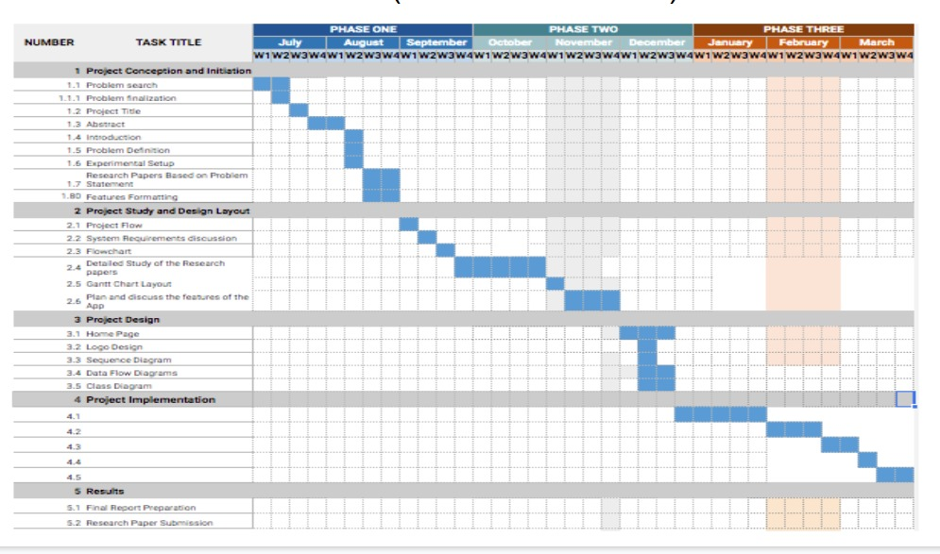
Gantt Chart
Agricultural Recommendation System using DL

